Slide 1
BED SLOT BOOKING MANAGEMENT SYSTEM
Department Of MCA, MES College Of Engineering Kuttippuram
26th October 2023
PREPARED BY
RUSHDHA M V (MES22MCA-2046)
PTEMBER 2022

Slide 2
GUIDED BY
Prof. PRIYA J D
ASSISTANT PROFESSOR
MASTER OF COMPUTER APPLICATIONS
MES COLLEGE OF ENGINEERING , KUTTIPPURAM

Slide 3
INTRODUCTION
The main objective of this project is to build an online bed slot booking platform, at pandemic condition like Covid 19 which allows a user to book a bed in a preferred hospital looking at the number of beds available. In the Covid Situation the main issue of the common people to get a bed and unavailability of oxygen and other treatment from hospital. This web application help the people to check the availability of the bed and book the bed. The project Bed Slot Booking System includes registration of patients, storing their details into the system .The software has the facility to give a unique id for every patient and stores the details of every patient automatically. It includes a facility to know the current status of availability of beds at each listed hospital.

Slide 4
CONTENTS
Introduction
Modules
Product Backlog
Project Plan
Sprint
Data Flow Diagram

Slide 5
MODULES
ADMIN
Login
Add Hospital
2)HOSPITAL
Login
Add , delete, update, edit hospital bed details
3)USER
Login
Register
Book Bed Slot
View detail

Slide 6
DEVELOPMENT ENVIRONMENT
SOFTWARE SPECIFICATION
Operating System
Frond End
Coding language
Framework
Backend
IDE
Browser
: Windows 7 or above
: HTML,CSS ,JAVASCRIPT,Bootstrap
:Python
:Flask
:SQLAlchemy
: Visual Studio Code
:Internet Explorer / Chrome / FireFox
HARDWARE SPECIFICATION
Processor
Hard Disk
RAM
: i3 or above
:80GB
:4GB or Above

Slide 7
PRODUCT BACKLOG
ID | PRIORITY | SIZE (Hours) | SPRINT | STATUS | NAME
1 | Medium | 3 | 1 | Planned | Registration
2 | Medium | 1 |  | Planned | Login
3 | High | 4 | 2 | Planned | Table Design
4 | High | 23 |  | Planned | Coding
5 | Medium | 4 | 3 | Planned | Testing data
6 | High | 6 |  | Planned | Output generation

Slide 8
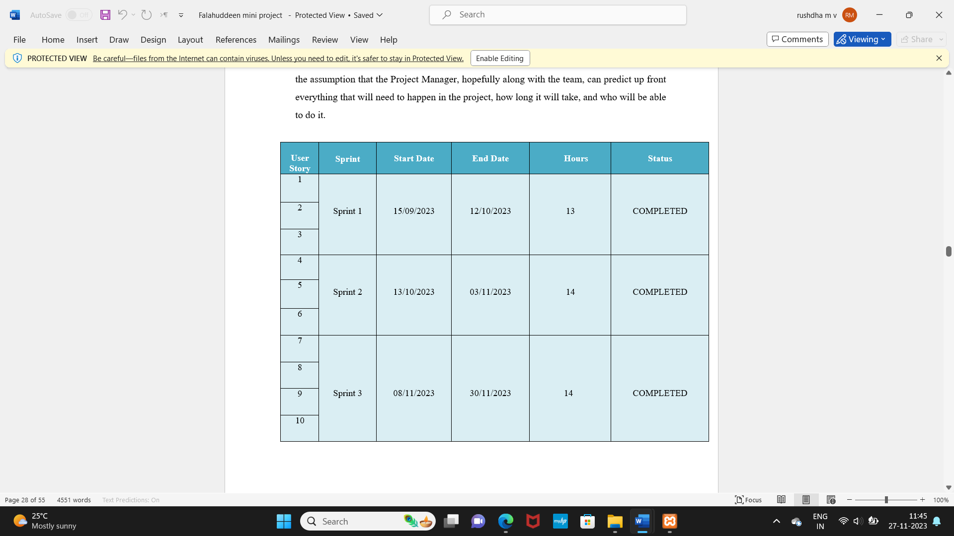
PROJECT PLAN

Slide 9
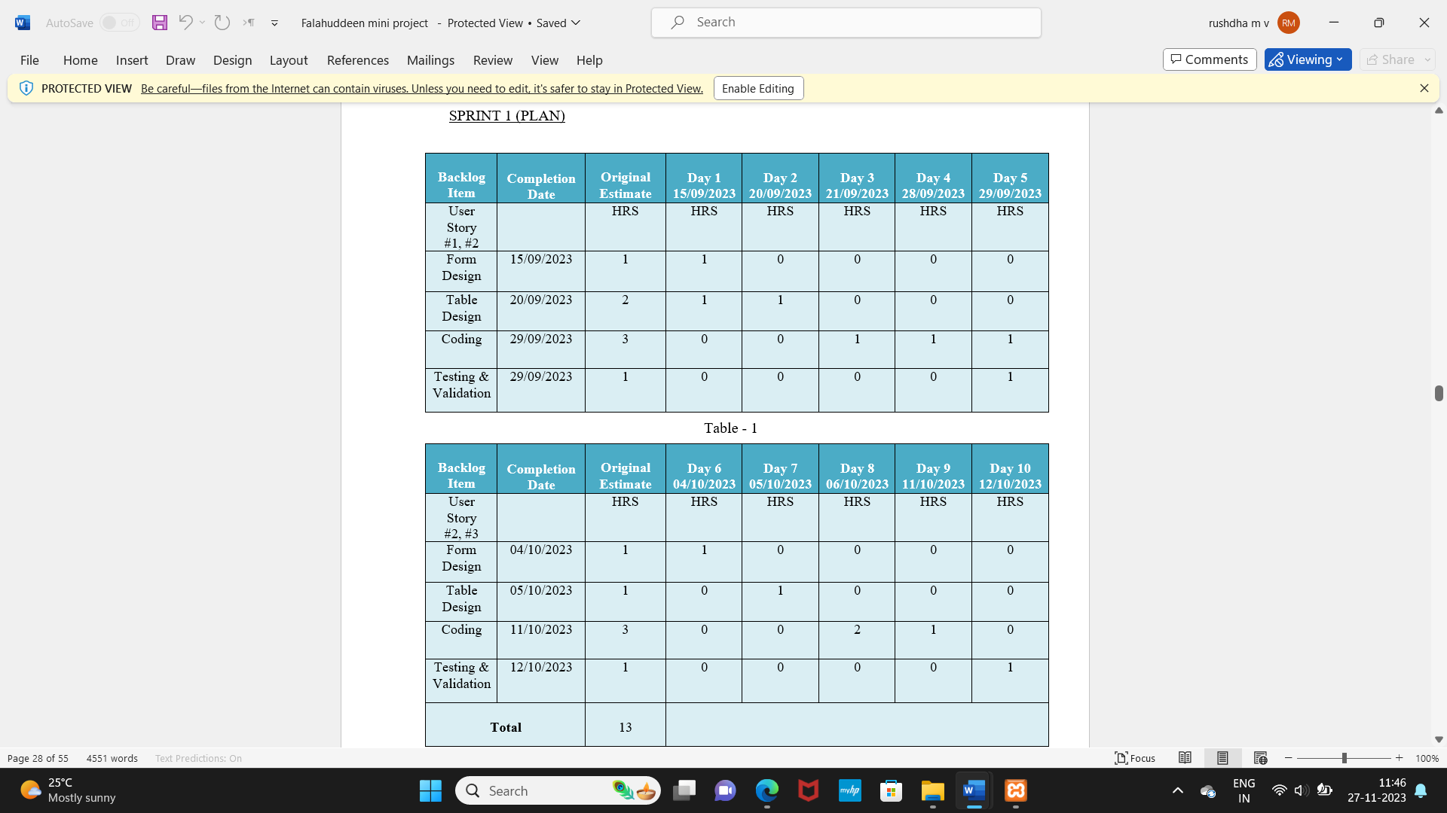
SPRINT PLAN
SPRINT 1

Slide 10
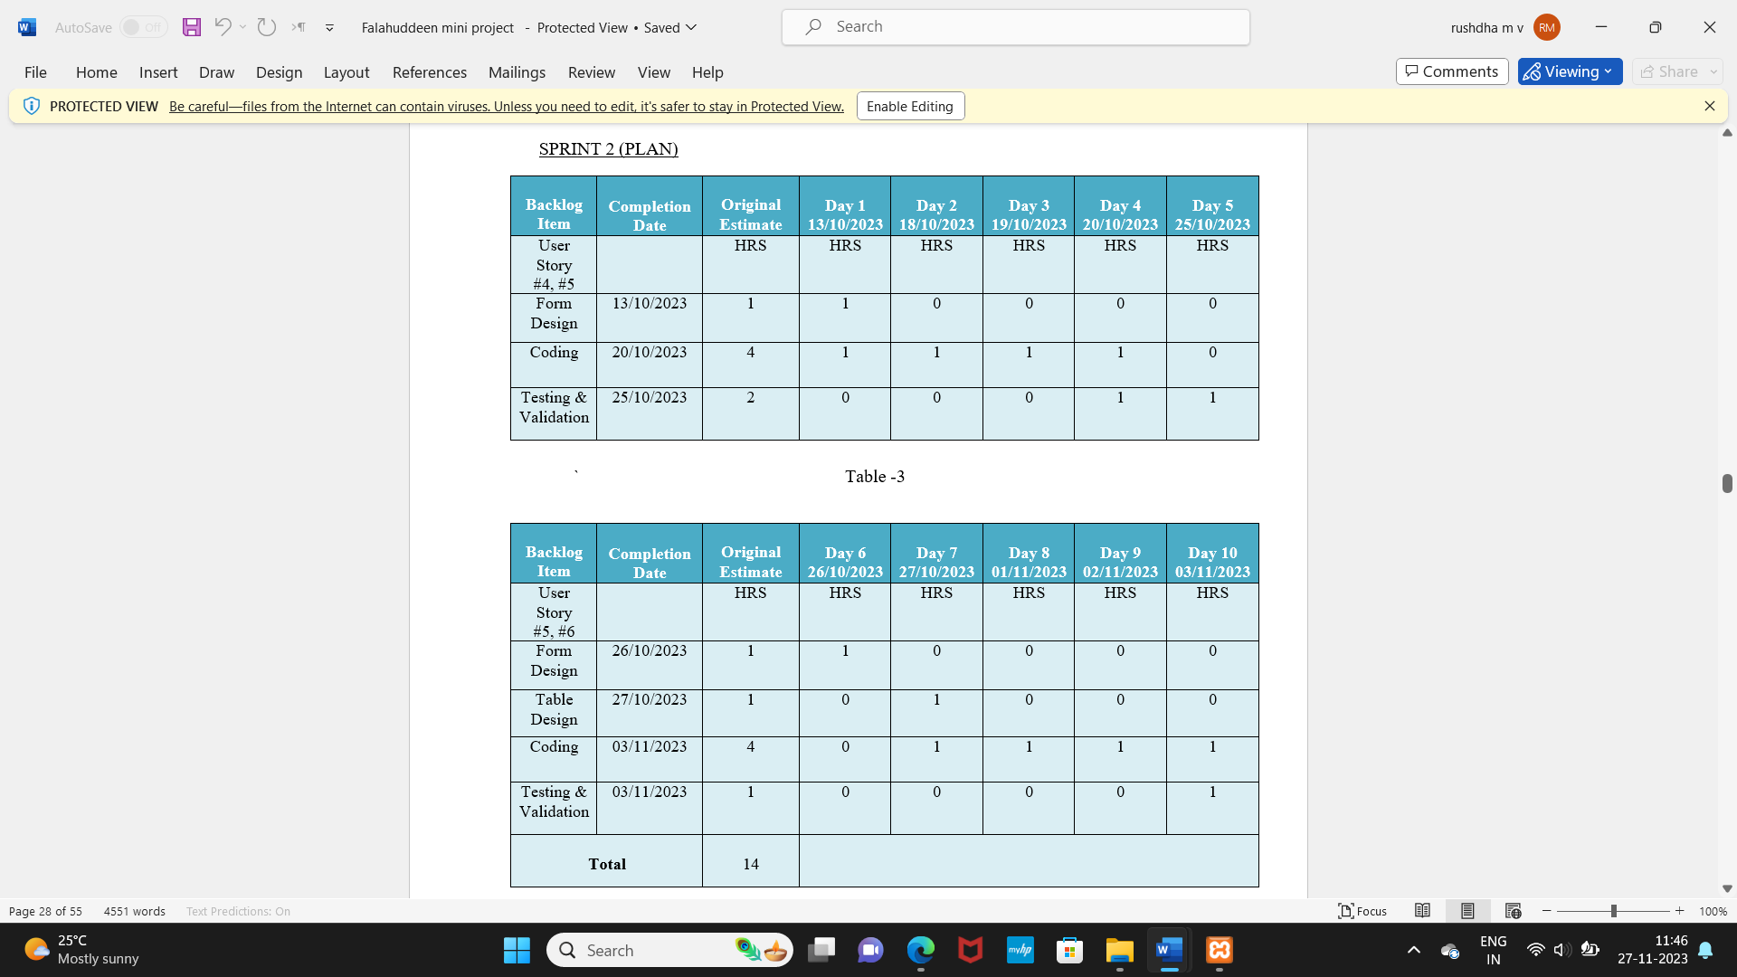
SPRINT PLAN
SPRINT 2

Slide 11
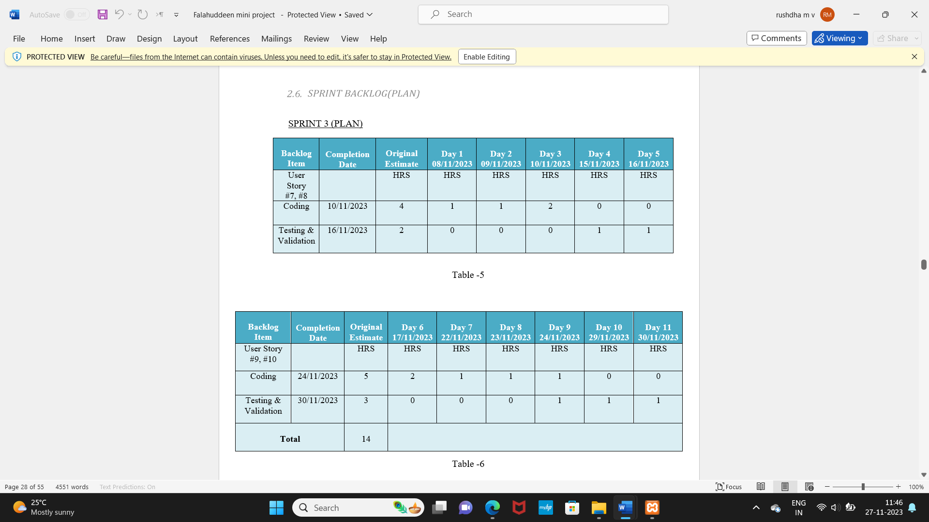
SPRINT PLAN
SPRINT 3

Slide 12
DATA FLOW DIAGRAM
LEVEL 0
ADMIN
BED SLOT
DATABASE
HOSPITAL
USER

Slide 13
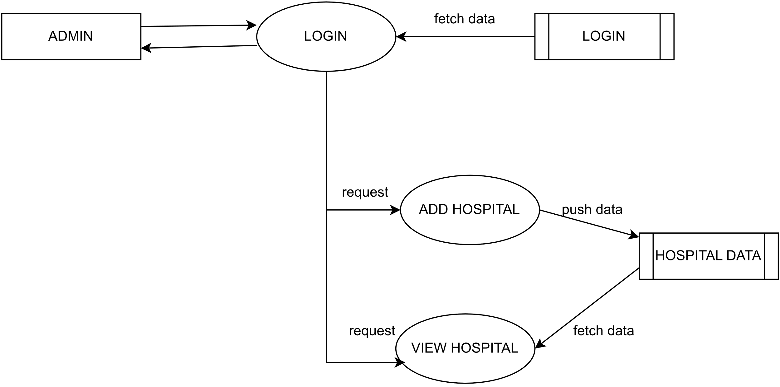
Level 1.1

Slide 14
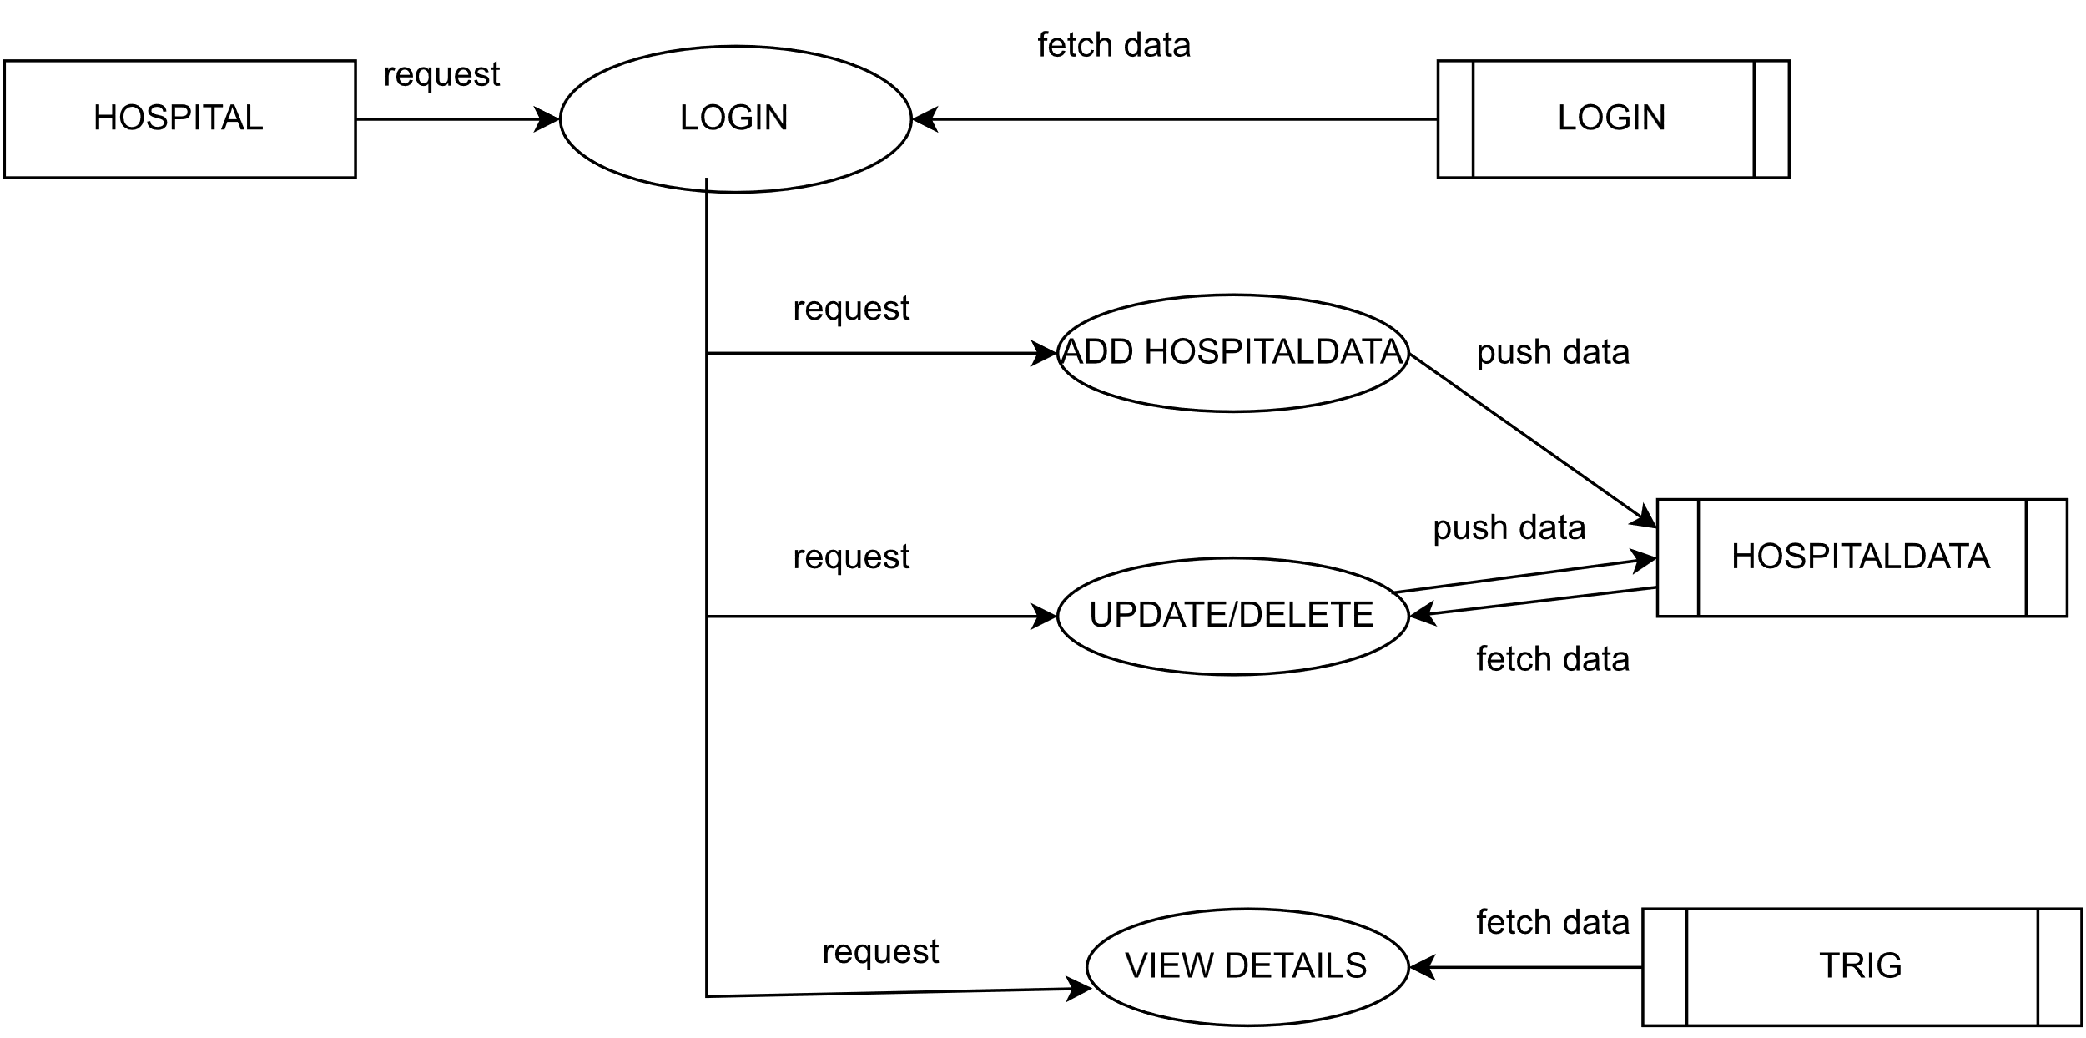
Level 1.2

Slide 15
Level 1.3

Slide 16
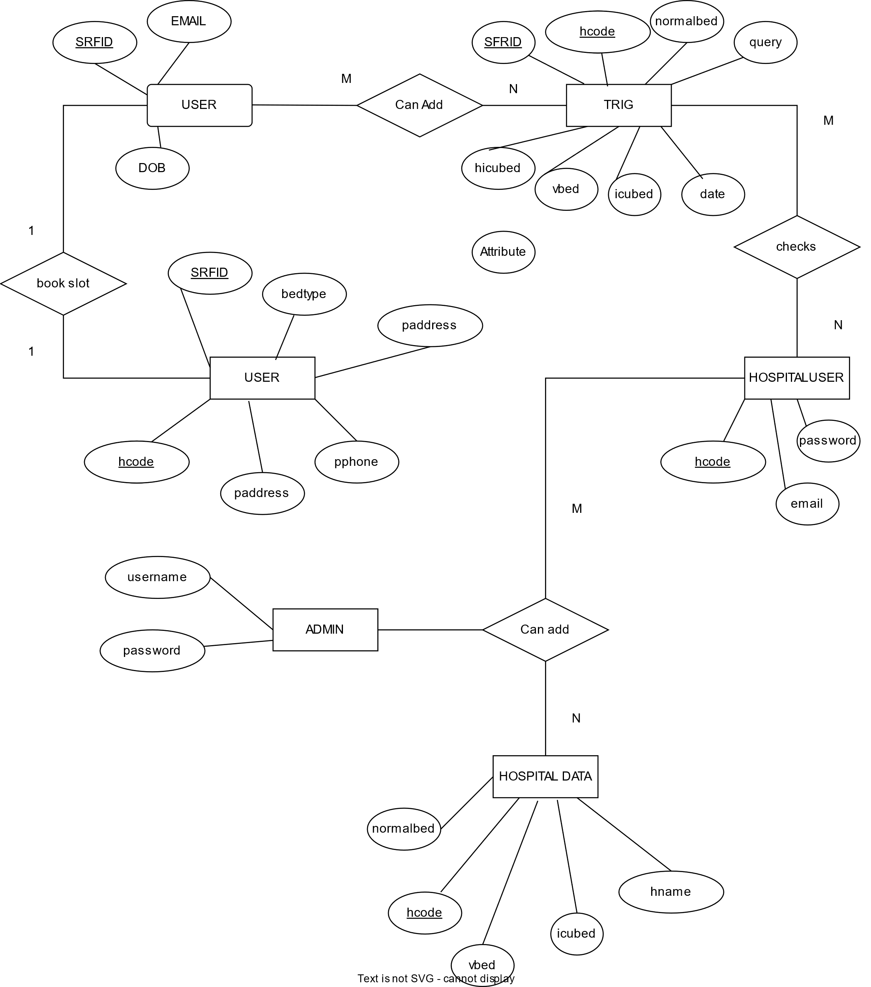
ER DIAGRAM

Slide 17
THANK YOU

